Slide 1
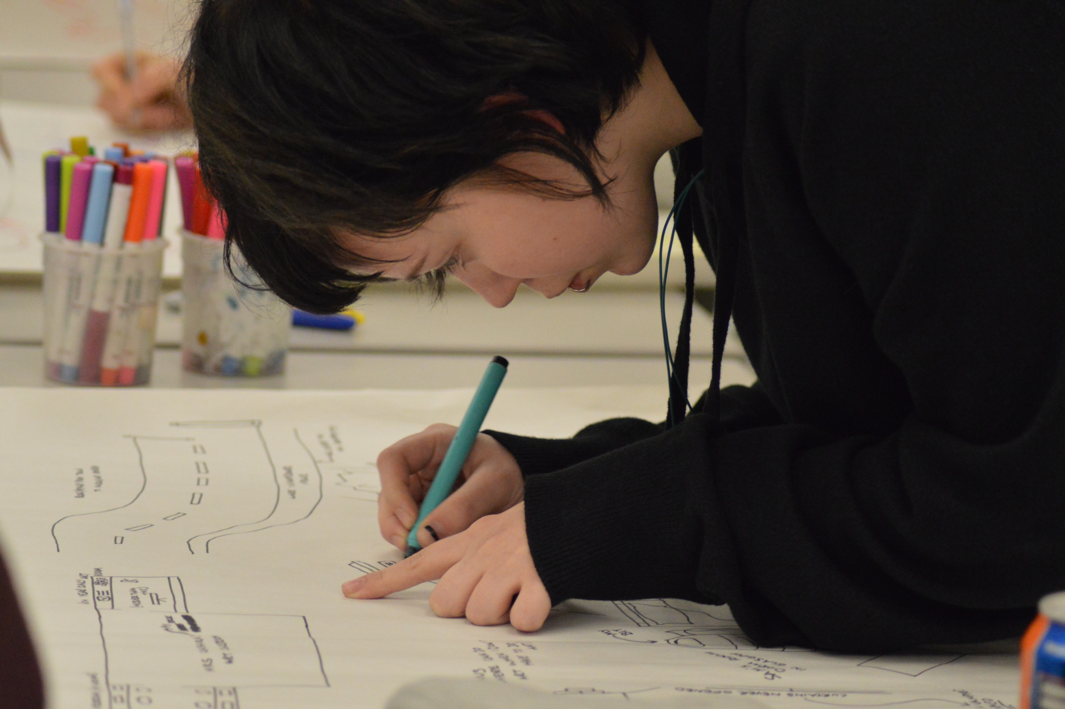



Standards in community contributions
Peigi MacKillop
peigi.mackillop@hes.scot

Slide 2


SUP 5 year HLF project 60 community led projects 190 events 1500 people gaining new skills 4000 registered users

Slide 3
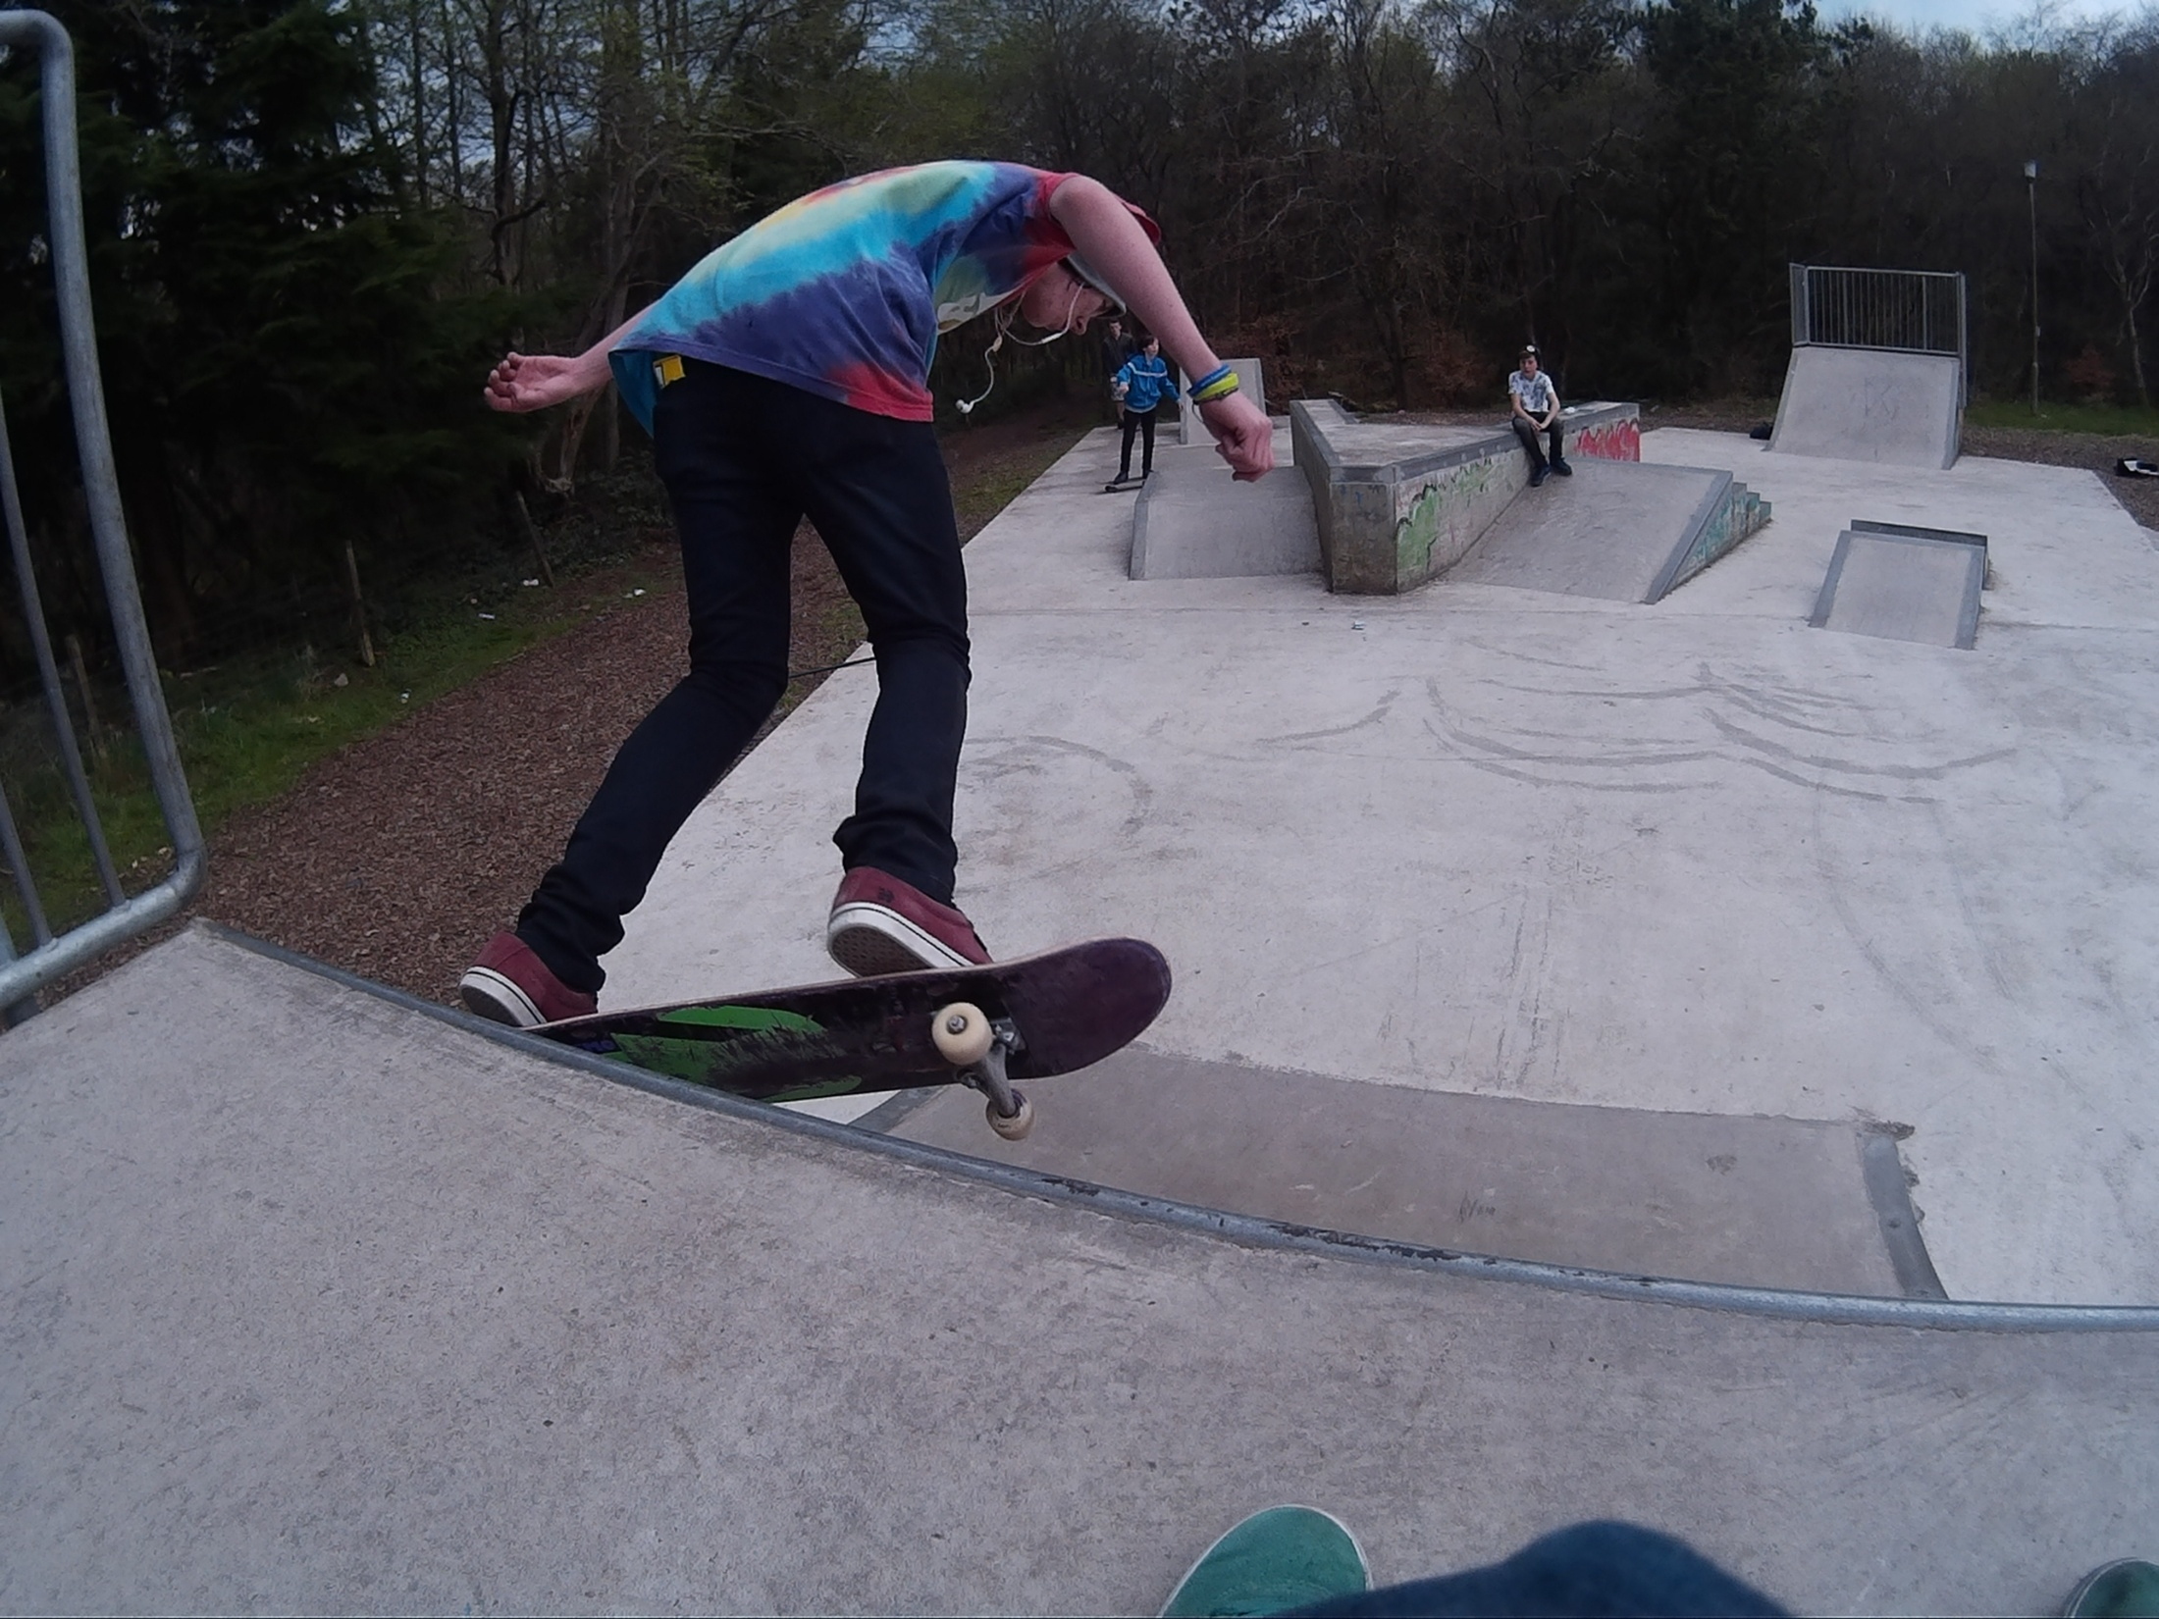
The Vennie, Livingston
Completed project
Youth club
Created film about skatepark
First skatepark in Canmore

Slide 4
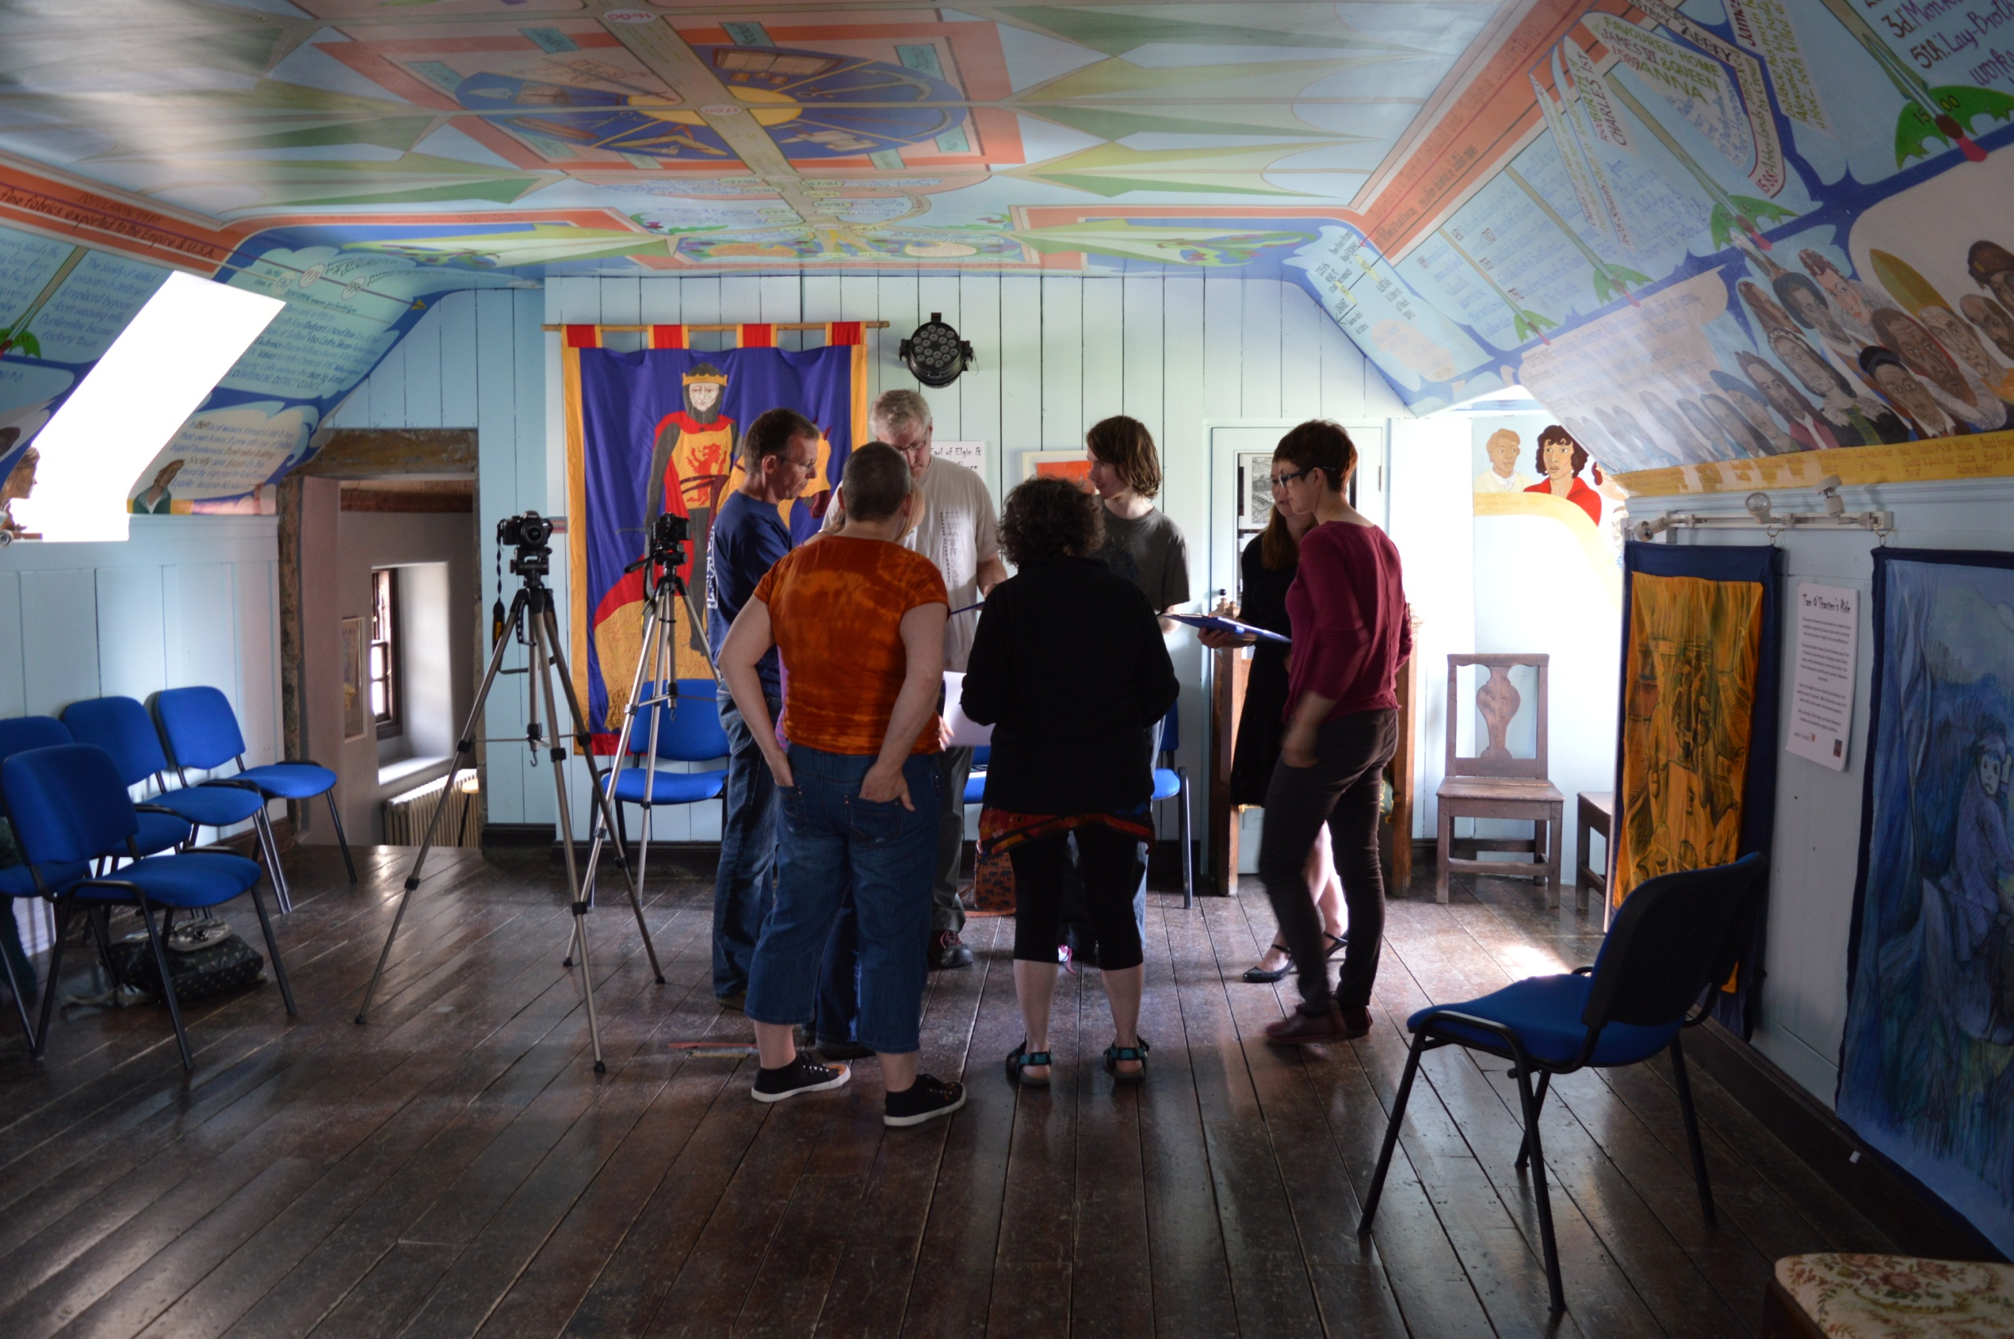
Abbot House, Dunfermline
Completed project
Traditional group
Recorded oral histories
Created film about the building and its uses

Slide 5
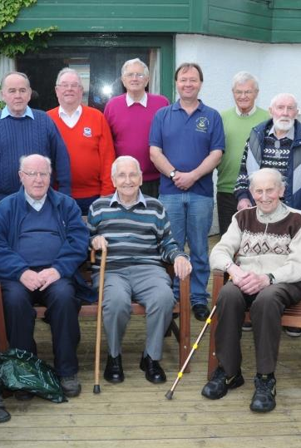
The Old Pals
Campbeltown
Initiated project
Non-traditional group
Aim to create archive of photographs and digital map of reminiscences of the changes to the fabric of Campbeltown

Slide 6
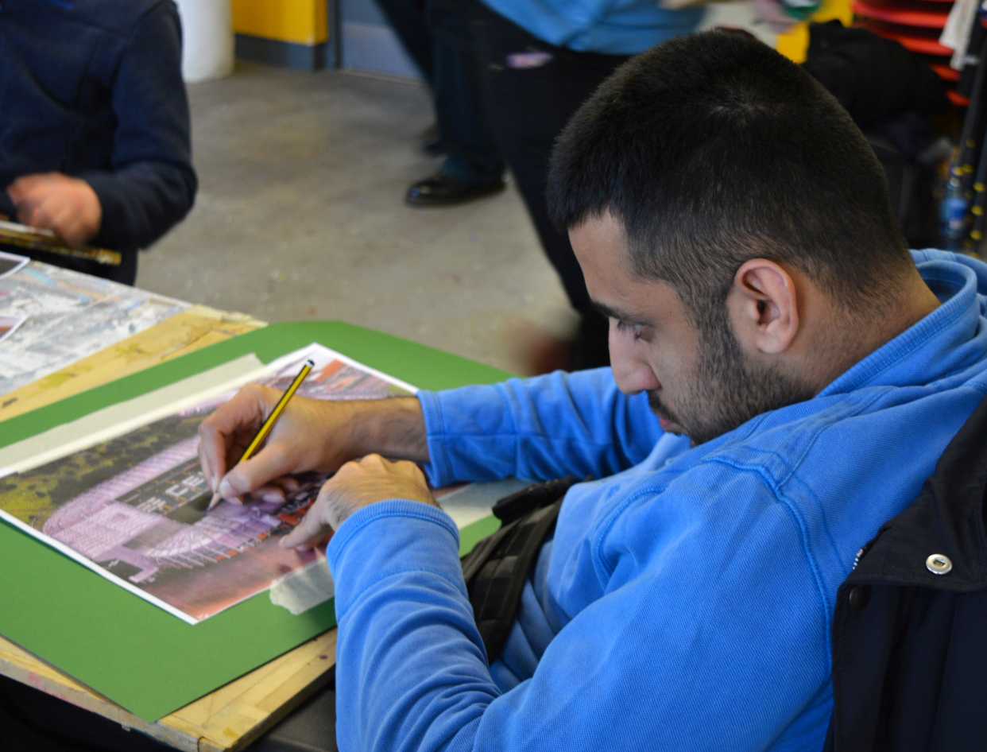
Glasgow Disability Alliance

Slide 7
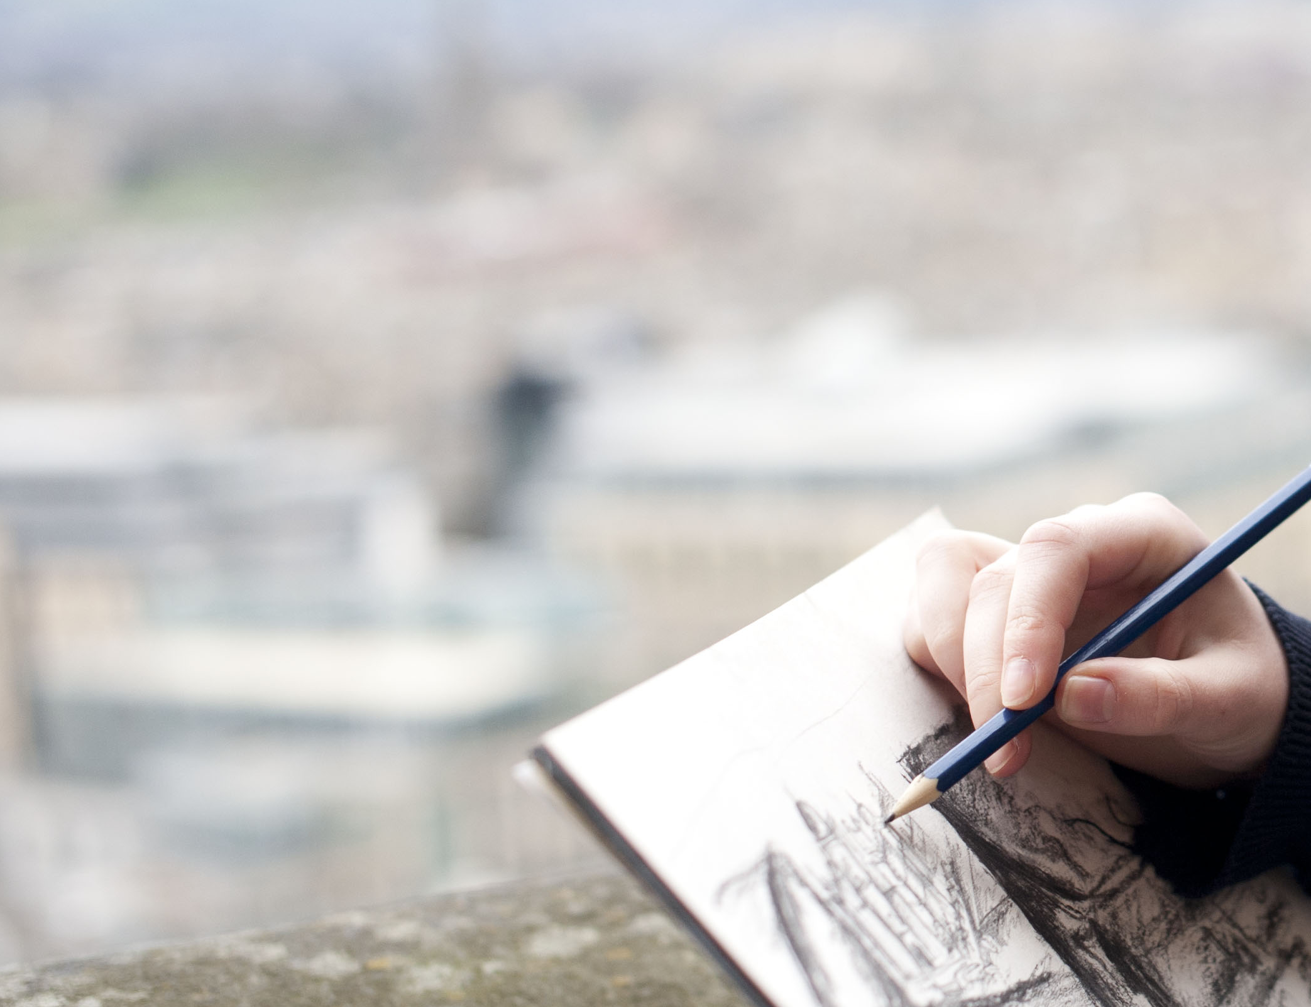
Standards
Selecting new sites to add using a map pin – avoids errors in transcription of grid references
GPS locator and mobile responsive
Controlled Vocabularies
English Heritage
Controlled Time Periods
Controlled Parish, district and postcode

Slide 8
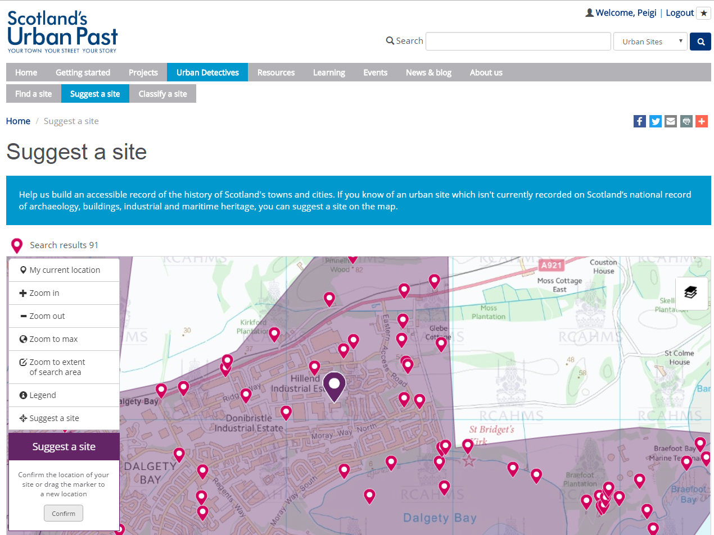

Slide 9
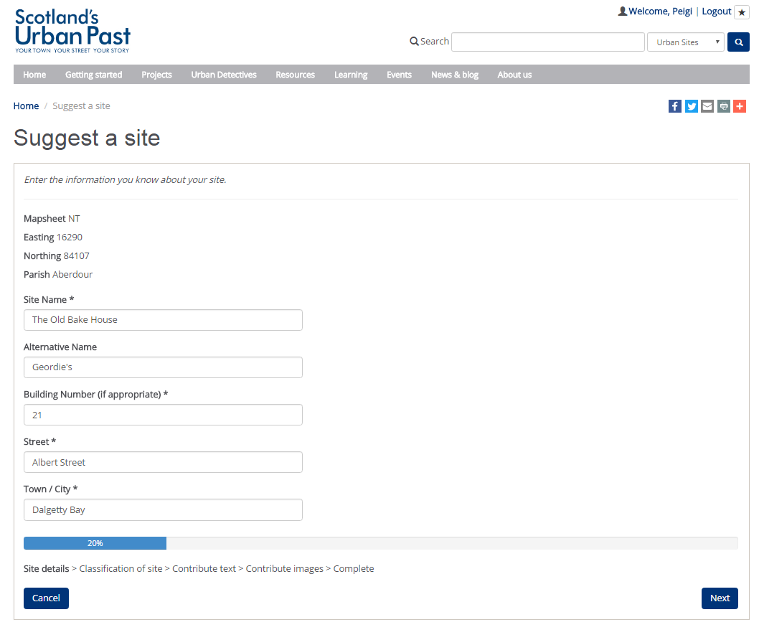

Slide 10
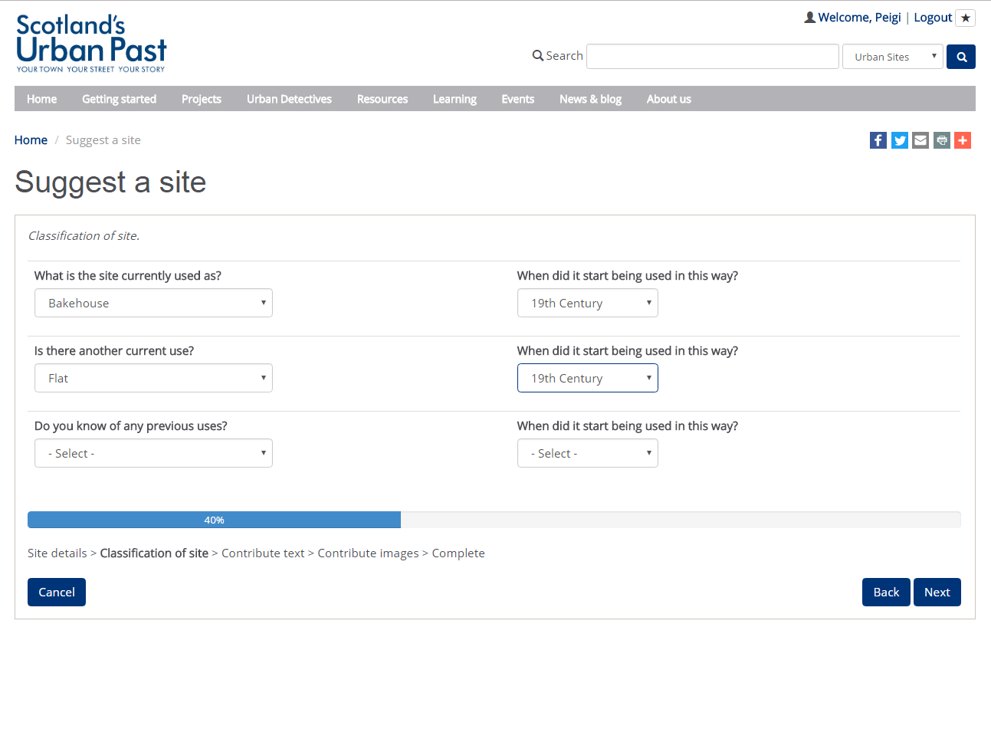

Slide 11
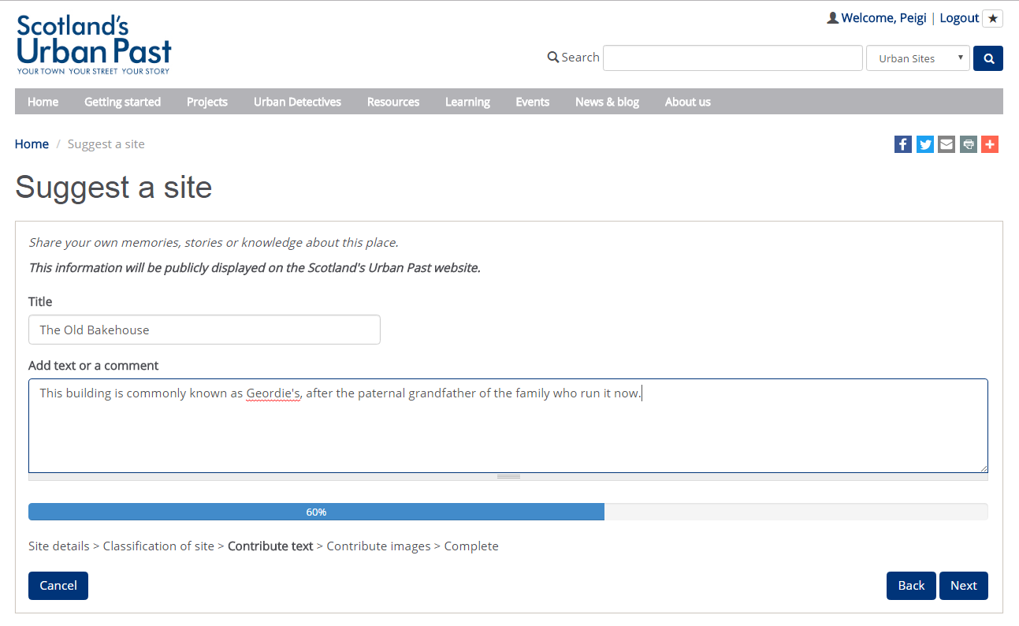

Slide 12
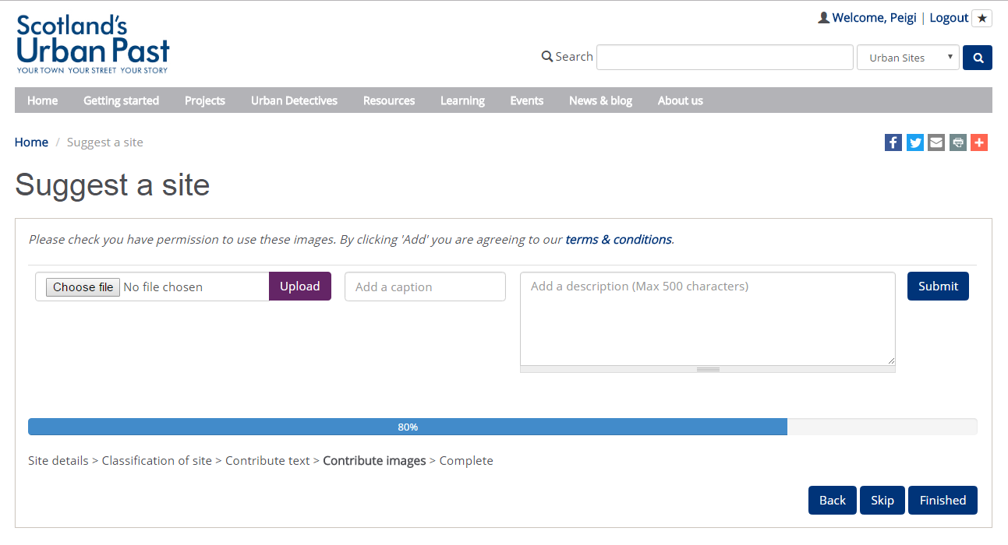

Slide 13
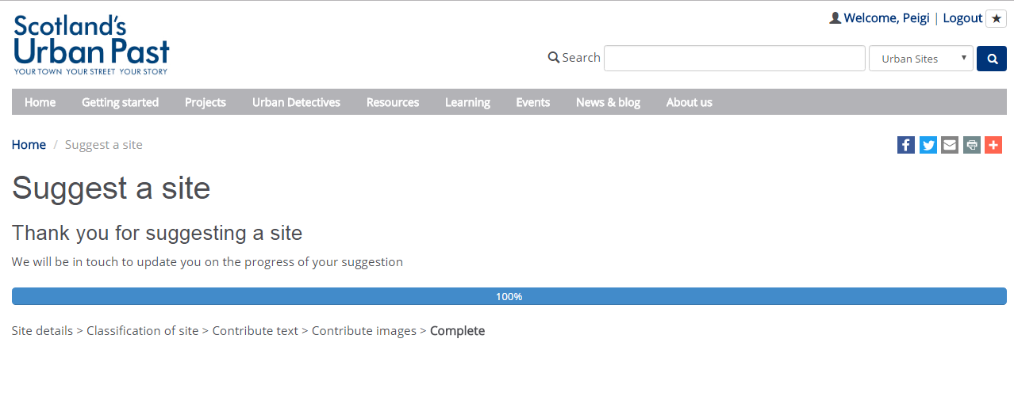

Slide 14
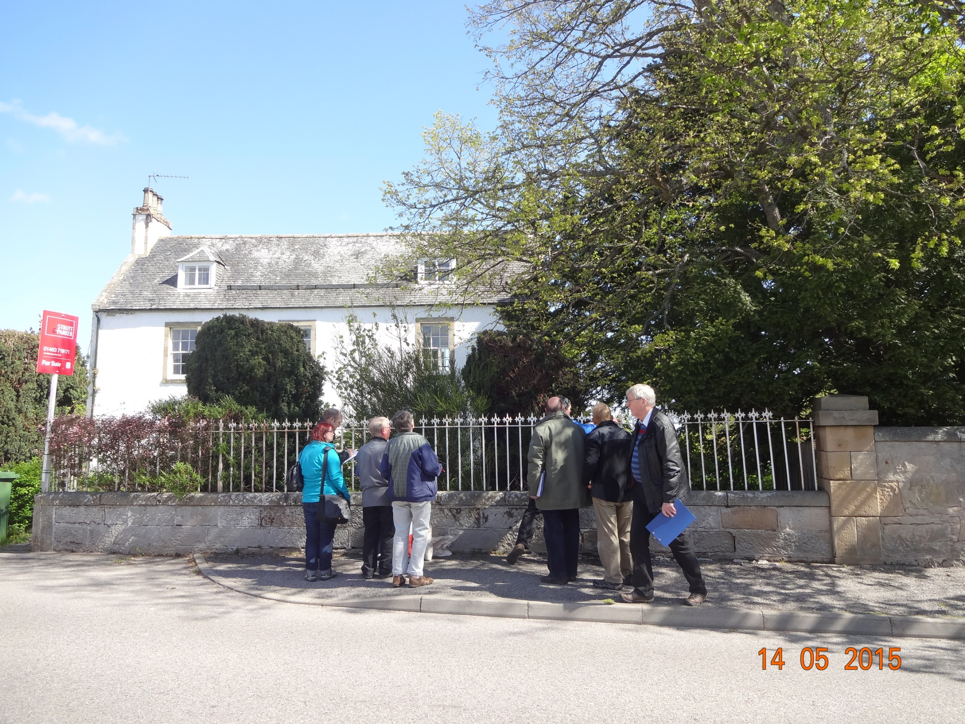
Upload multiple images > 10mb Upload reports; pdf and word
Expert
Urban Detective
Expert Urban Detective

Slide 15
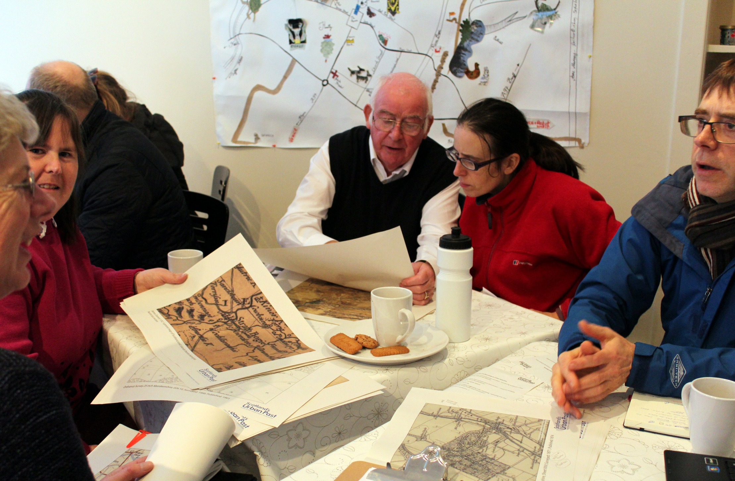
Huntly Histories

Slide 16


Peigi MacKillop
Peigi.mackillop@rcahms.gov.uk
@ScotUrbanPast
Find us on Facebook

